Slide 1
Introduction to Compiler
2CS701 Compiler Construction
Prof Monika Shah
Nirma University

Slide 2
Outline
Course overview
Compiler and Interpreter
Other types of compiler
Analysis and Synthesis Model of compilation
Phases of compiler
Cousins of compiler
Other applications of compilation techniques

Slide 3
Course Overview
2CS701 Compiler Construction
Introduction :
  The course will discuss how a program written in H.L.L.(higher level language) is systematically translated into L.L.L(low level language)
  It also help you to understand various programming constructs and their semantics
Prerequisites:
  C/C++ programming skill,
  Data structure
Course website : https://lms.nirmauni.ac.in/course/view.php?id=4849
for : Syllabus, LP/LOP, Handouts, References, Assignment, Forum
Textbook: “Compilers: Principles, Techniques, and Tools” by Aho, Sethi, and Ullman

Slide 4
Objective & Course Learning Outcomes
Objective
To make student understand programming language constructs, and
give them hands-on experience with crafting a simple compiler using modern software tools.
Course Learning Outcomes
Summarize the functionalities of various phases of compiler
Apply language theory concepts to various phases of compiler design
Identify appropriate optimization technique for compilation process
Develop a miniature compiler using appropriate compiler design tool

Slide 5
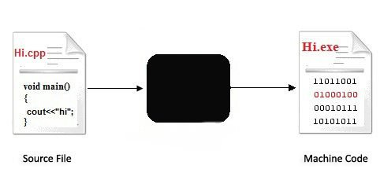
Compilers and Interpreters
“Compilation”
  Translation of a program written in a source language into a semantically equivalent program written in a target language
Input
Compiler
Equivalent
Program in
Machine Language
Program in
Source Language
Error messages
Output
Notes:
Use: A compiler can be used to transform source code into a format that is easier to understand and to optimize.
The most common use : to translate source code written in a programming language like C or Java into machine code that is understood by the computer's processor.

Slide 6
Compilers and Assembler
Compiler
Hi.asm (Assembly code)
Input
Program in
Source Language
Assembler
Error messages
Output
Notes:
Use: A compiler can be used to transform source code into a format that is easier to understand and to optimize.
The most common use : to translate source code written in a programming language like C or Java into machine code that is understood by the computer's processor.

Slide 7
Compiler
Translation of a program written in a source language into a semantically equivalent program written in a binary/machine dependent language
Compiler | Source Language | Target Language
Gcc | C | Binary / Machine Language
G++ | C++ | Binary / Machine Language
Javac | Java | Byte Code
Input
Source
Program
Compiler
Target Program
Error messages
Output

Slide 8
Interpreters
Translation of an instruction of a program written in a source language into a semantically equivalent instruction written in a target (machine) language
Execute translated line with given input
E.g. Debugger , command line interpreter , Python Interpreter, Perl Interpreter, PHP interpreter
Source Program
Interpreter
Output
Input
Error messages

Slide 9
Types of compilers
Basic Ahead of Time (AOT) Compilers: translate entire code into machine code before execution i.e. GCC for C,C++, Fortran,
Just-In-Time Compiler : Translating code at runtime. i.e. HotSpot Java Virtual Machine (JVM)
Incremental Compiler : Recompile only the modified parts of a program. E.g. Eclipse Java Development Tools (JDT)
Interpreting Compilers : combine compilation and interpretation, translating high-level code into intermediate code, which is then interpreted. E.g.
  Matlab - Interpreter with JIT Compilation
  Python (Cpython) - Interpreter with Bytecode Compilation

Slide 10
Types of compilers
Cross Compilers: They produce an executable machine code for a platform but, this platform is not the one on which the compiler is running.
Applications:
  to separate build environment from target environment.
  Often use for Embedded system design.
  To support multiple operating systems or several versions of operating systems
  Examples:
  a compiler that runs on a PC but generates code that runs on an Android smartphone is a cross compiler.
  Android NDK (Native Development Kit). The Android NDK includes tools like clang and gcc that allow you to compile C and C++ code for Android devices

Slide 11
Types of compilers
Source to source compiler / Transpiler / Transcompiler : takes the source code of a program written in a programming language as its input and produces the equivalent source code in the same or a different programming language.
Applications :
  An automatic parallelizing compiler will frequently take in a HLL program as an input and then transform the code and annotate it with parallel code (e.g., OpenMP)
  translating legacy code to use the next version of the underlying programming language or an API that breaks backward compatibility
Compiler | Source Language | Target Language
Cfront | C++ | C
HPHPc | PHP | C++
JSSweet | Java | Typescript

Slide 12
Types of compilers
Bootstrap Compilers. These compilers are written in a programming language that they have to compile.
  Can compile its own source code
  E.g. GCC, LLVM
Decompiler : translates an executable file to a high-level source file which can be recompiled successfully.

Slide 13
Self Evaluation
Is JavaC Compiler or Interpreter?
Is compiler faster than Interpreter? How?
What is need of Decompiler ?

Slide 14
The Analysis-Synthesis Model of Compilation
There are two parts to compilation:
  Analysis
    Understand source program as per program language used in source program
    determines the operations implied by the source program which are recorded in a tree structure
  Synthesis
    takes the tree structure and translates the operations there in target language and compile it into the target program
Source
Program
Compiler
Target
Program
Syntax
Tree
Synthesis
Analysis

Slide 15
Other Tools that Use the Analysis-Synthesis Model
Editors (syntax highlighting)
Pretty printers (e.g. Doxygen)
Static checkers (e.g. Lint and Splint)
Interpreters
Text formatters (e.g. TeX and LaTeX)
Silicon compilers (e.g. VHDL)
Query interpreters/compilers (Databases)
Circuit design from K-map

Slide 16
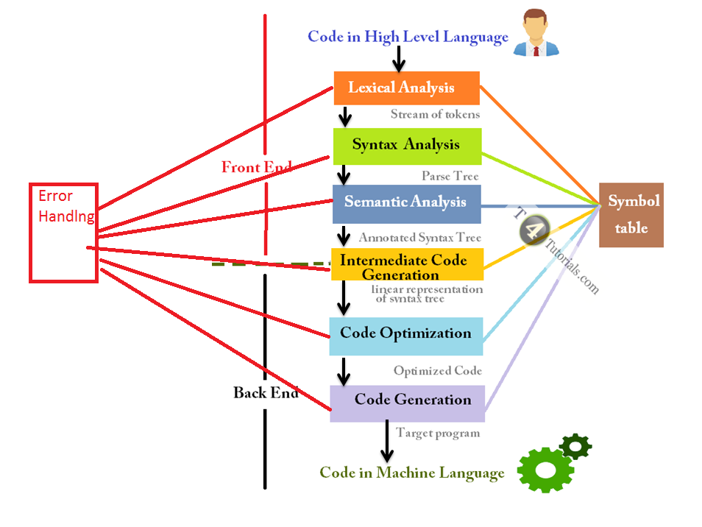
The Phases of a Compiler

Slide 17
The Phases of a Compiler
Phase | Output | Sample
Programmer (source code producer) | Source string | A=A/5.2;
Scanner (performs lexical analysis) | Token string | ID ‘=‘ ID ‘%’ FLOAT ‘;’ And symbol table with names
Parser (performs syntax analysis based on the grammar of the programming language) | Parse tree or abstract syntax tree Or Syntax Error | ; | = / \ ID % / \ ID FLOAT
Semantic analyzer (type checking, etc) | Annotated parse tree or abstract syntax tree | Error:‘%’ operator should have both operand integer. ID ‘=‘ ID ‘%’ fp2Int(FLOAT)
Intermediate code generator | Three-address code, quads, or RTL | fp2int 5.2 t1 % A t1 t2 := t2 A
Optimizer | Three-address code, quads, or RTL | fp2int 5.2 t1 % A t1 A
Code generator | Assembly code | MOVF #5.2,r1 ADDF2 r1,r2 MOVF r2,A
Peephole optimizer | Assembly code | ADDF2 #5.2,r2 MOVF r2,A

Slide 18
Cousins of compiler playing crucial role in compilation process
Preprocessors, Compilers, Assemblers, and Linkers
Skeletal Source Program
Preprocessor
Source Program
Compiler
Try for example:
gcc -v myprog.c
Target Assembly Program
Assembler
Relocatable Object Code
Linker
Libraries and
Relocatable Object Files
Absolute Machine Code

Slide 19
Self Evaluation
Which compiler phase is optional ? Why?
Which compiler phase concept can be apply in text editor for spell check?
Which compiler phase concept can be apply in text editor for grammar check?
“Compiler can generate assembly code as output”. State True/False. Justify
Does compiler recognize semantic error and reports it?
What is difference between code optimization phase before and after code generation?

Slide 20
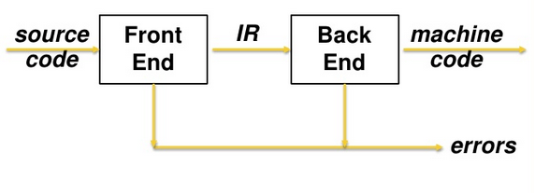
The Grouping of Phases
Compiler passes:
  Single pass:
    Read source code once
    Read one part, process all phases, read next part
    Does not look code previously processed
    Require everything to be defined before. Else Use Backpatch
    Require large memory
  Multi pass: Every pass results new representation and input to next pass
    Compiler front and back ends:
    Front end: analysis (machine independent)
    Back end: synthesis (machine dependent)

Slide 21
Other Applications of techniques used in compiler design
Lexical Analyzer → text editors, information retrieval system, and pattern recognition programs. E.g. pretty printers apply stylist formatting to source code, markup like text using indenting styles, coloring token classes
Syntax Analyzer → query processing system such as SQL, K-map to circuit design
Syntax Analyzer + semantic analyzer → Equation solver
  Most of the techniques used in compiler design can be used in Natural Language Processing (NLP) systems.

Slide 22
Other Application of Lexical Analyzer
E.g. Pretty-printing : Formatting coding
int foo(int k)
{
if(k<1||k>2)
{
printf("out of range\n");
printf(“Requires a value of 1 or 2\n");
}
else
{
printf("Switching\n");
}
}
int foo(int k){if(k<1||k>2)
{printf("out of range\n");
printf(“Requires a value of 1 or 2\n");}
else{printf("Switching\n");}}
GNU Indent Program

Slide 23
Self Evaluation
What are advantages and disadvantages of single pass compiler and multi-pass compiler?
Why is it preferred to keep front-end phases and back-end phases into different pass?
Find at-least 3 applications of compiler techniques other than compiler

